Slide 1
Memory Allocation and Address Space
Course: Operating Systems
Instructor: AWOTUNDE J. B.
Date: 09Th November 2025

Slide 2
Background
Program must be brought into memory and placed within a process for it to be run.
To improve both the utilization of the CPU and the speed of its response to users, a general-purpose computer must keep several processes in memory.
OS provides Many memory-management schemes to improve memory utilization.
Input queue or job queue – collection of processes on the disk that are waiting to be brought into memory to run the program.
OS has to perform various steps in order to execute the processes such as address and data binding.
11.<number>

Slide 3
Memory management requirements
Relocation: Branch addresses and data references within a program memory space (user address space) have to be translated into references in the memory range a program is loaded into.
Protection: Each process should be protected against unwanted (unauthorized) interference by other processes, whether accidental or intentional. Fortunately, mechanisms that support relocation also form the base for satisfying protection requirements.

Slide 4
Sharing : Allow several processes to access the same portion of main memory : very common in many applications. Ex. many server-threads executing the same service routine.
Logical organization : allow separate compilation and run-time resolution of references. To provide different access privileges (RWX). To allow sharing. Ex: segmentation.

Slide 5
Physical organization: Memory hierarchy or level of memory. Organization of each of these levels and movement and address translation among the various levels.
Overhead : should be low. System should be spending not much time compared execution time, on the memory management techniques.

Slide 6
Addresses Binding
  There are two types of addresses: logical address and physical address.
  Logical address is generated by CPU during a program execution. It is also called as virtual address.
  Physical Address identifies a physical location in a memory unit.
  Set of all logical addresses generated by CPU in reference to a program is referred as Logical Address Space.
  Set of all physical addresses mapped to the corresponding logical addresses is referred as Physical Address Space.
  Address binding is the process of mapping from one address space to another address space.
11.<number>

Slide 7
Address Binding can happen at three different stages:
Compile-time Address Binding:
  It will be done before loading the program into memory.
  Compiler is responsible for performing address binding.
  The compiler requires interacts with an OS memory manager to perform compile-time address binding.
Load time Address Binding:
  It will be done after loading the program into memory.
  This type of address binding will be done by the OS memory manager i.e loader.
11.<number>

Slide 8
Execution time / Dynamic Address Binding:
  Binding done by the processor at the time of program execution.
  Need hardware support for address maps.
  The program will be kept on changing the locations in memory until the time of program execution.
MMU(Memory Management Unit)
The run time mapping between Virtual address and Physical Address is done by hardware device known as MMU.
In memory management, Operating System will handle the processes and moves the processes between disk and memory for execution.
It keeps the track of available and used memory.

Slide 9
Dynamic Loading
In dynamic loading, a routine is not loaded until it is called.
All routines are kept on disk in a relocatable load format.
The main program is loaded into memory and is executed.
When a routine needs to call another routine, the calling routine first checks to see whether the other routine has been loaded.
If it has not, the relocatable linking loader is called to load the desired routine into memory and to update the program’s address tables to reflect this change.
Then control is passed to the newly loaded routine.
The advantage of dynamic loading is to provide better memory-space utilization.
11.<number>

Slide 10
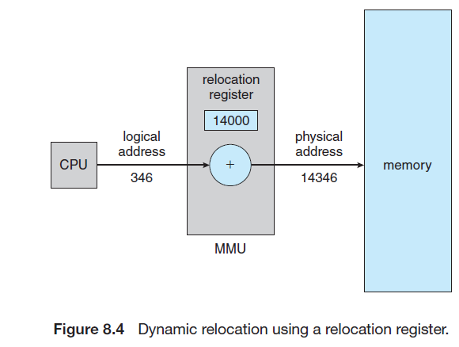
11.<number>

Slide 11
Overlays in Memory Management
Overlay memory management technique allows multiple programs to be loaded into memory simultaneously, but only a portion of each program is resident in memory at any given time.
The technique swaps different parts of the programs in and out of memory as required.
It is commonly used in situations where the memory requirements of the programs exceed the available physical memory.
Advantages
  Improved Memory Utilization
  Reduced Memory Fragmentation
  Reduced Memory Access Time
  Improved Performance
11.<number>

Slide 12
Disadvantages
  Increased Complexity
  Limited Address Space
  Increased Overhead

Slide 13
Logical vs. Physical Address Space
An address generated by the CPU is commonly referred to as a logical address, whereas an address seen by the memory unit—that is, the one loaded into the memory-address register of the memory—is commonly referred to as a physical address.
The compile-time and load-time address-binding methods generate identical logical and physical addresses.
However, the execution-time address binding scheme results in differing logical and physical addresses.
In this case, we usually refer to the logical address as a virtual address.

Slide 14
Logical vs. Physical Address Space
We use logical address and virtual address interchangeably in this text.
The set of all logical addresses generated by a program is a logical address space.
The set of all physical addresses corresponding to these logical addresses is a physical address space.
Thus, in the execution-time address-binding scheme, the logical and physical address spaces differ.
The run-time mapping from virtual to physical addresses is done by a hardware device called the memory-management unit (MMU).

Slide 15
Logical vs. Physical Address Space
The concept of a logical address space that is bound to a separate physical address space is central to proper memory management
  Logical address – generated by the CPU; also referred to as virtual address
  Physical address – address seen by the memory unit
Logical and physical addresses are the same in compile-time and load-time address-binding schemes; logical (virtual) and physical addresses differ in execution-time address-binding scheme
Logical address space is the set of all logical addresses generated by a program
Physical address space is the set of all physical addresses generated by a program

Slide 16
Dynamic Loading
In our discussion so far, it has been necessary for the entire program and all data of a process to be in physical memory for the process to execute.
The size of a process has thus been limited to the size of physical memory.
To obtain better memory-space utilization, we can use dynamic loading.
With dynamic loading, a routine is not loaded until it is called.
All routines are kept on disk in a relocatable load format.
The main program is loaded into memory and is executed.
When a routine needs to call another routine, the calling routine first checks to see whether the other routine has been loaded,
if it has not, the relocatable linking loader is called to load the desired routine into memory and to update the program’s address tables to reflect this change.
Then control is passed to the newly loaded routine.

Slide 17
Dynamic Loading
The advantage of dynamic loading is that a routine is loaded only when it is needed.
This method is particularly useful when large amounts of code are needed to handle infrequently occurring cases, such as error routines.
In this case, although the total program size may be large, the portion that is used (and hence loaded) may be much smaller.
Dynamic loading does not require special support from the operating system.
It is the responsibility of the users to design their programs to take advantage of such a method.
Operating systems may help the programmer, however, by providing library routines to implement dynamic loading.

